Slide 1
Chapter 1 Background
Fundamentals of Java: AP Computer Science Essentials, 4th Edition
Lambert / Osborne

Slide 2
About the Presentations
The presentations cover the objectives found in the opening of each chapter.
All chapter objectives are listed in the beginning of each presentation.
You may customize the presentations to fit your class needs.
Some figures from the chapters are included. A complete set of images from the book can be found on the Instructor Resources disc.
‹#›

Slide 3
Objectives
Give a brief history of computers.
Describe how hardware and software make up computer architecture.
Explain the binary representation of data and program in computers.
‹#›
‹#›

Slide 4
Objectives (continued)
Discuss the evolution of programming languages.
Describe the software developmental process.
Discuss the fundamental concepts of object-oriented programming.
‹#›
‹#›

Slide 5
Vocabulary
application software
assembly language
auxiliary input/output (I/O)
auxiliary storage device
bit
byte
central processing unit (CPU)
hardware
information hiding
instance variables
internal memory
machine language
‹#›
‹#›

Slide 6
Vocabulary (continued)
network connection
object-oriented programming
primary memory
RAM
secondary memory
software
software development life cycle (SDLC)
system software
ubiquitous computing
user interface
waterfall model
‹#›
‹#›

Slide 7
History of Computers
ENIAC (1940s) was one of the world’s first digital electronic computers.
IBM sold its first business computer in the 1950s.
It was thought the world needed no more than 10.
Power was 1/2000 of the typical laptop of today.
Today there are hundreds of millions of laptop and desktop computers in the world.
‹#›
‹#›

Slide 8
History of Computers (continued)
The first computers could perform only a single task at a time.
Paper cards and tape used for input and output.
In 1960s, time-sharing computers were sold for businesses.
Cost up to millions of dollars.
30 people could work at once.
Teletypes used phone wires.
‹#›
‹#›

Slide 9
History of Computers (continued)
In 1970s, e-mail and file transfers were born.
In 1980s, personal computers and local area networks were available.
In 1990s, an explosion of computer use and availability of Internet access.
Computing has become ubiquitous.
Cell phones, cameras, PDAs, music players
‹#›
‹#›

Slide 10
Computer Hardware and Software
Computers are machines that process information.
Hardware are the physical devices on your desktop.
Software are the programs that give the hardware functionality.
Bits and Bytes:
Bits are the smallest unit of information processed by a computer (0s and 1s).
Bytes are eight bits.
‹#›
‹#›

Slide 11
Computer Hardware and Software (continued)
Computer Hardware:
Computers have six major subsystems:
User interface
Auxiliary input/output (I/O)
Keyboard, monitor, printer, digital camera, joystick
Auxiliary storage devices
Secondary memory
Hard disks, DVDs, flash memory
Network connection
Modem, TV cable, satellite dish, Ethernet cards
‹#›
‹#›

Slide 12
Computer Hardware and Software (continued)
Computer Hardware (cont):
Internal memory (RAM)
RAM (random access memory) is primary memory
ROM (read-only memory)
Central processing unit (CPU)
Performs basic tasks using complex hardware.
Moore’s Law: speed is doubled every two years
Transistor is the building block of the CPU and RAM.
‹#›

Slide 13
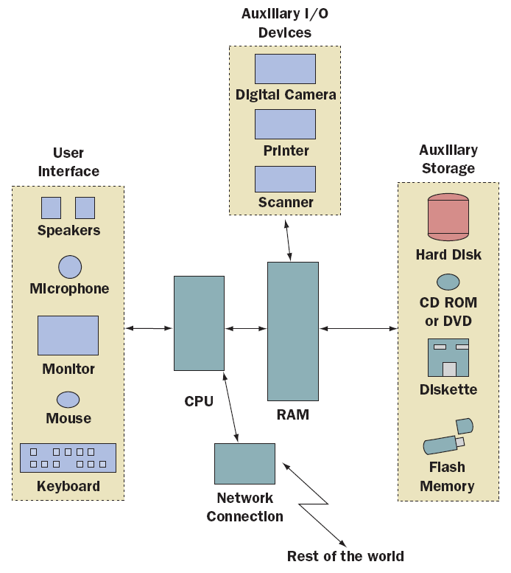
Computer Hardware and Software (continued)
A computer’s six major subsystems
‹#›
‹#›

Slide 14
Computer Hardware and Software (continued)
Computer Software:
System software
Supports the operations of the computer.
Includes the operating system, communication software, compilers, and the user interface subsystem.
Application software
Allows users to accomplish tasks.
Types include Word processors, spreadsheets, databases, and multimedia.
‹#›
‹#›

Slide 15
Binary Representation of Information and Computer Memory
Computer memory stores patterns of electronic signals.
The patterns are strings of binary digits or bits.
Computers use binary (base 2) notation.
Two bases: On/Off
Computer scientists also use bases octal (8) and hexadecimal (16).
‹#›
‹#›

Slide 16
Binary Representation of Information and Computer Memory (continued)
Floating-Point numbers
Fractions
Use mantissa/exponent notation
Characters and Strings
ASCII, represents patterns as bytes
Java uses Unicode
Patterns of 15 bits from 0000 0000 0000 0000 to 1111 1111 1111 1111
‹#›
‹#›

Slide 17
Binary Representation of Information and Computer Memory (continued)
Floating-Point numbers
Fractions
Use mantissa/exponent notation
Characters and Strings
ASCII, represents patterns as bytes
Java uses Unicode
Patterns of 15 bits from 0000 0000 0000 0000 to 1111 1111 1111 1111
‹#›
‹#›

Slide 18
Binary Representation of Information and Computer Memory (continued)
Sound is analog data.
Analog information has a continuous range of infinite values.
Sampling reads the waveform at intervals.
Memory requirements for sound are higher than text.
Images
Sampling measures color values as pixels in a two-dimensional grid.
Grayscale, black-and-white, RGB, true-color
‹#›
‹#›

Slide 19
Binary Representation of Information and Computer Memory (continued)
Video
Video includes a soundtrack and a set of images called frames.
Data compression is difficult.
Program instructions
A sequence of bits in RAM
Computer Memory
A gigantic sequence of bytes, each with an address.
‹#›
‹#›

Slide 20
Programming Languages
Generation 1 (Late 1940s to Early 1950s)-Machine Languages:
Programs were coded in machine language, whose only symbols are binary digits.
Coding was tedious, slow, and error-prone.
It was difficult to modify programs.
Each type had its own machine language so programs were not portable.
‹#›
‹#›

Slide 21
Programming Languages (continued)
Generation 2 (Early 1950s to Present)-Assembly Languages:
Assembly languages use mnemonic symbols to represent instructions & data.
Programs are translated by assembler and loaded and run using a loader.
Assembly language is more programmer friendly, but still tedious.
Like machine language, it is not portable as each computer has its own unique language.
‹#›
‹#›

Slide 22
Programming Languages (continued)
Generation 3 (Mid-1950s to Present)-High-Level Languages:
Examples of high-level languages are FORTRAN, COBOL, BASIC, C, Pascal, C++, Python, Smalltalk, and Java.
High-level languages are easy to write, read, understand.
Translation to machine language is done using a compiler.
Java does not need to be recompiled for each type of computer.
‹#›
‹#›

Slide 23
The Software Development Process
Software development life cycle (SDLC)
Waterfall method:
Customer request (user requirements)
Analysis
Design
Implementation (coding)
Integration
Maintenance
‹#›
‹#›

Slide 24
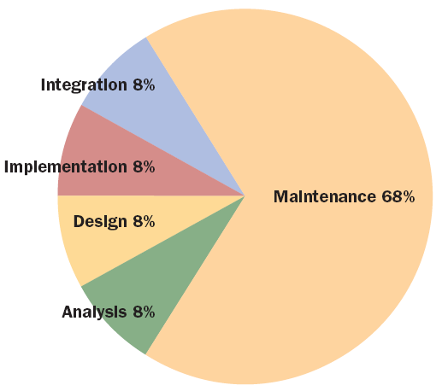
The Software Development Process (continued)
Percentage of total cost incurred in each phase of the development process
‹#›
‹#›

Slide 25
Basic Concepts of Object-Oriented Programming
High-level programming languages fall into two major groups.
The older languages, COBOL, FORTRAN, BASIC, C, and Pascal, all use a procedural approach.
New languages, Smalltalk, C++, Python, and Java use an object-oriented approach.
Object-oriented is considered superior.
‹#›
‹#›

Slide 26
Basic Concepts of Object-Oriented Programming (continued)
Object-oriented programming (OOP) process is the process of programming with objects.
Steps: planning, execution, outcome
Programs are composed of different types of software components called classes.
Classes define:
Instance variables (data resources)
Methods (rules of behavior)
Combining resources and behaviors into a single software entity is encapsulation.
‹#›
‹#›

Slide 27
Basic Concepts of Object-Oriented Programming (continued)
An executing program is composed of interacting objects.
An object is an instance of the class that describes its resources and behavior.
Objects send messages to each other to accomplish the mission of the program.
Information hiding provides access to services but not data resources.
‹#›
‹#›

Slide 28
Basic Concepts of Object-Oriented Programming (continued)
Classes are organized into hierarchies.
Subclasses share methods and instance variables with the root class using inheritance.
Different types of objects can understand the same message, called polymorphism.
An object’s response to a message depends on its class.
‹#›
‹#›

Slide 29
Summary
In this chapter, you learned:
The modern computer age began in the late 1940s with the development of ENIAC. Business computing became practical in the 1950s, and time-sharing computers advanced computing in large organizations in the 1960s and 1970s. The 1980s saw the development and first widespread sales of personal computers, and the 1990s saw personal computers connected in networks. During the first decade of the twenty-first century, computing has become ubiquitous.
‹#›
‹#›

Slide 30
Summary (continued)
Modern computers consist of two primary components: hardware and software. Computer hardware is the physical component of the system. Computer software consists of programs that enable us to use the hardware.
All information used by a computer is represented in binary form. This information includes numbers, text, images, sound, and program instructions.
‹#›
‹#›

Slide 31
Summary (continued)
Programming languages have been developed over the course of three generations: generation 1 is machine language, generation 2 is assembly language, and generation 3 is high-level language.
The waterfall model of the software development process consists of several standard phases: customer request, analysis, design, implementation, integration, and maintenance.
‹#›
‹#›

Slide 32
Summary (continued)
Object-oriented programming is a style of programming that can lead to better-quality software. Breaking code into easily handled components simplifies the job of writing a large program.
‹#›
‹#›

